Slide 1
Entrant Essentials 2: What you need to know about Teaching and Learning at St Andrews
Disability Team
disability@st-andrews.ac.uk

Slide 2
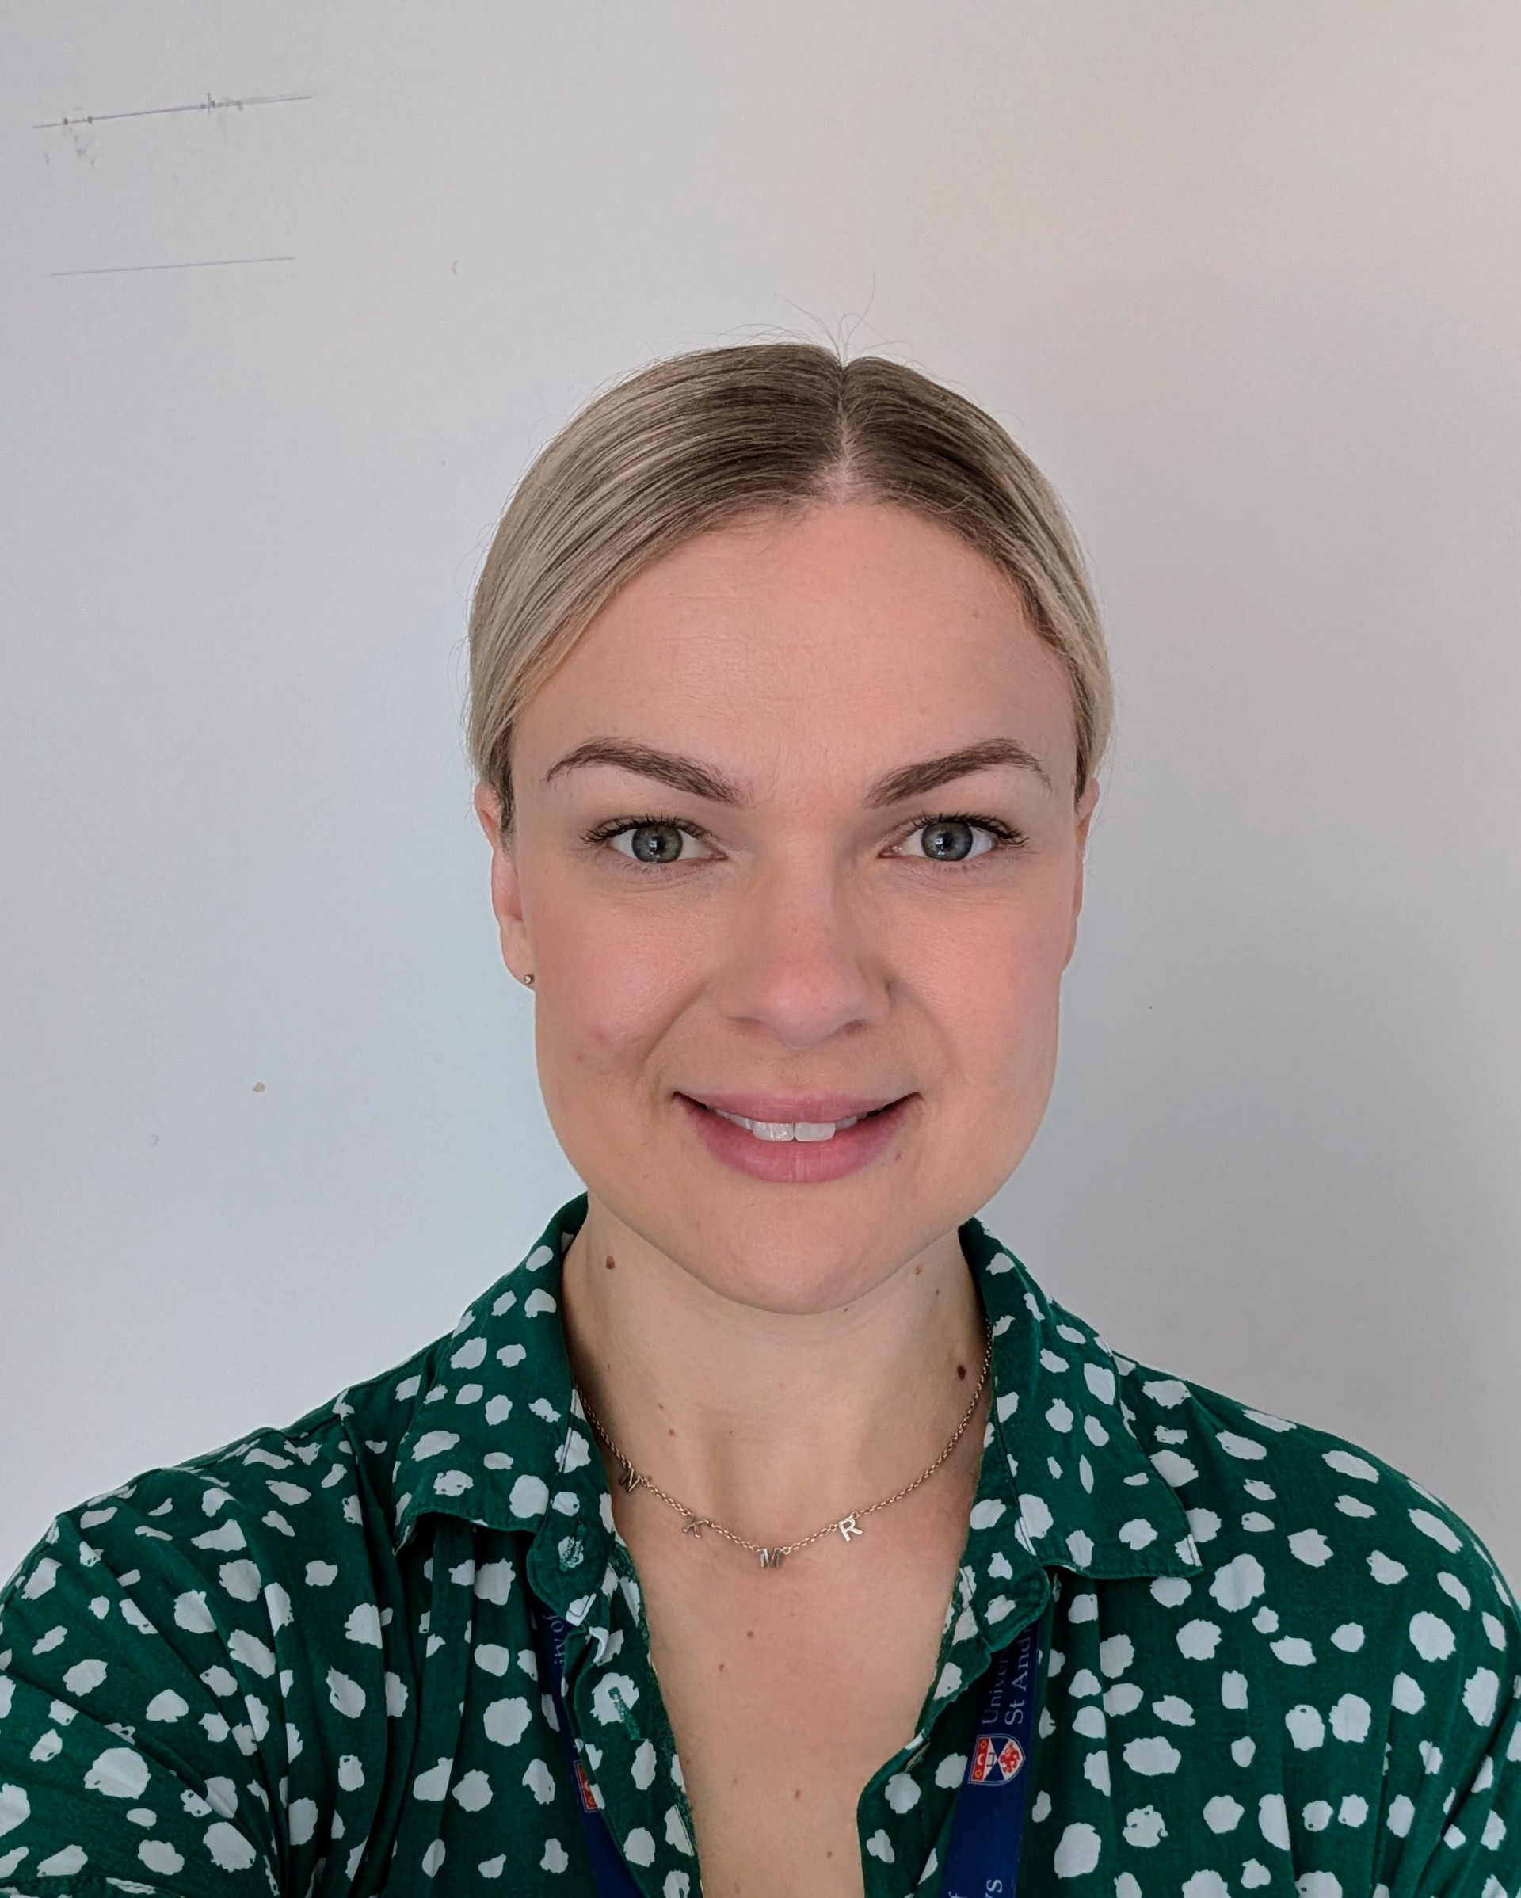
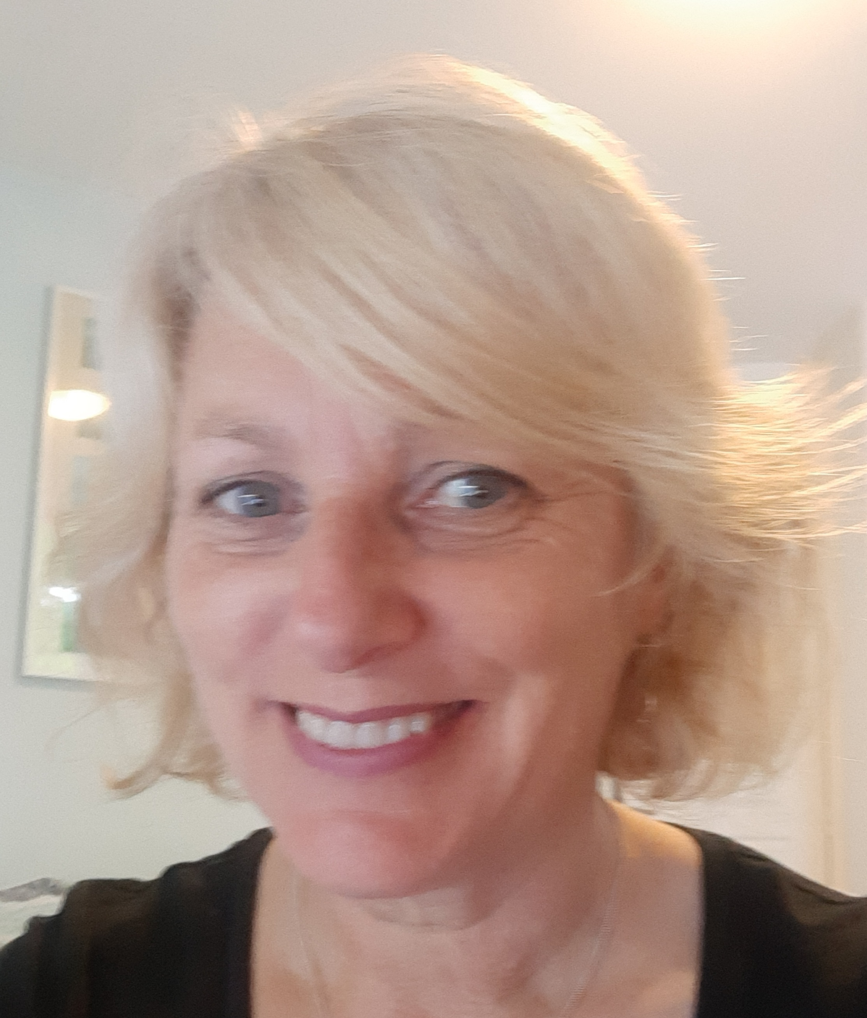
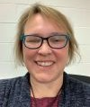
Student Services Disability Team
Director of Student Services
Dr Lara Meischke​
Assistant Director –
Sarah Scott
Disability Advisers – John Petrie, Michelle Petrie, Kate Leavy​, Kim Cartright, Stephanie Beaumont, Katie Easton, Delyth Henderson
Digital Accessibility Adviser – Ros Walker

Slide 3
Academic Advising
Meeting with Academic Adviser to make your module choices
Email notification of Academic Advising meeting
Matriculation dependent on attendance at meeting

Slide 4
Your Timetable
Timetable information
Personal timetable - MySaint: ‘Events’ tab.
Web Timetables – Module class times
Frequently asked questions

Slide 5
Teaching and Learning
Semester dates
Modules – student handbooks
MMS – Module Management System
Moodle
Outlook 365, including Outlook, etc.

Slide 6
Lectures and Seminars/Tutorials
IT software packages
Current Students
Lectures
Tutorials

Slide 7
Forms of Assessment
Submission deadlines
Class tests
Group work
Presentations
Exams

Slide 8
Teaching and Exam Arrangements
Disability Adviser Meeting
Teaching and exam arrangements
Here are some of the adjustments that may be made: ​
Examination arrangements e.g. extra time ​
Lecture slides issued in advance ​
Support to access assistive technology ​
Support with alternative formatting of information ​
(The list is not exhaustive and not relevant to all students).

Slide 9
Postgraduate Research (PGR) Students
Disability Adviser meeting
Disabled Student Allowance (UK students, if eligible)
Postgraduate Researcher Induction

Slide 10
Library
Library resources
Disability Adviser meeting

Slide 11
Tools and resources for self-service solutions
Sensus Access
Captioning
Mac and Windows accessibility solutions
Windows: http://windows.microsoft.com/en-US/windows/help/accessibility
OS X: http://www.apple.com/accessibility/macosx/vision.html

Slide 12
Academic Supports
Study Skills Toolkit
International Education and Lifelong Learning Institute (IELLI)
School Disability Coordinators
Academic office hours/class hours
Alternative Format Suite

Slide 13
Any questions?

Slide 14
Thank you for joining us!

